Slide 1
DAnce LEarning
(DALE)
Collin Abidi, Jarod Vickers

Slide 2
Refresher
Generation
Solution
Actually creating new stuff
Train a GAN (with LSTM) to learn data distribution
Generating a Dance Sequence with Song as Input
Solution
Data
Solution
Time-Series Prediction
Find/create dataset with human poses as coordinates and songs converted to frequency-domain
Use LSTM/RNN to deal with time-series data
Training on data with time as a variable
Data has to come from somewhere
Collin

Slide 3
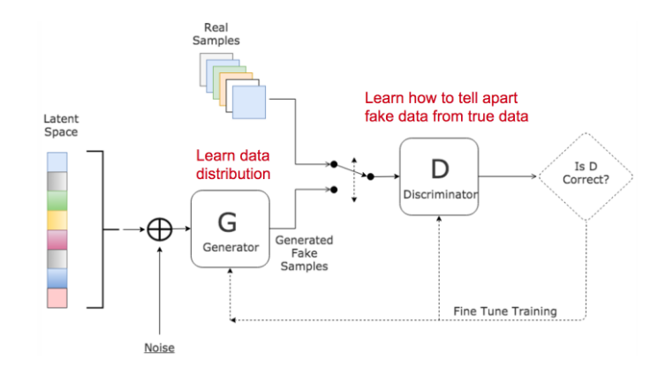
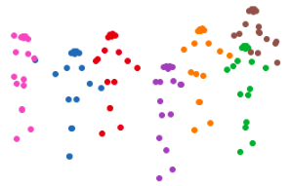
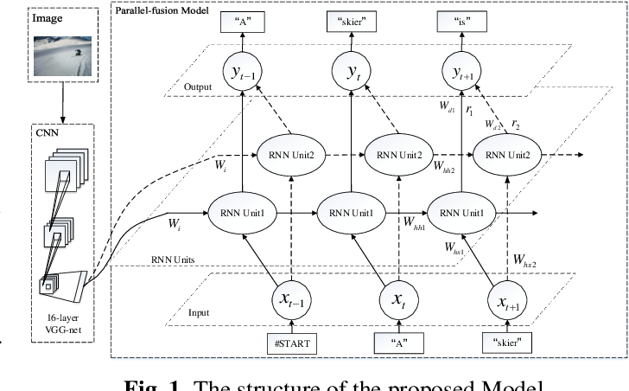
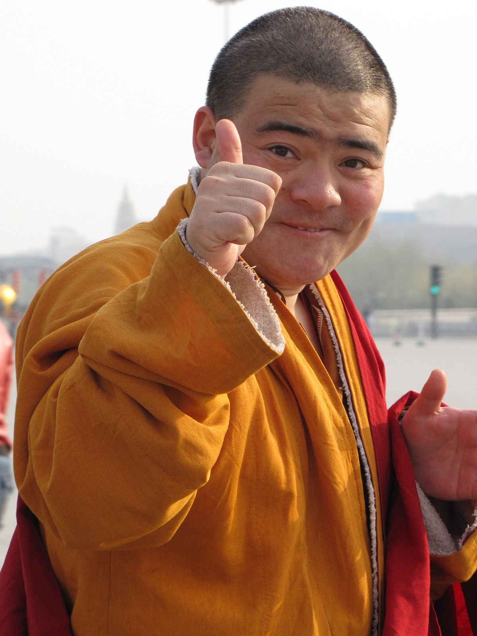
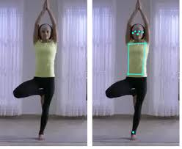
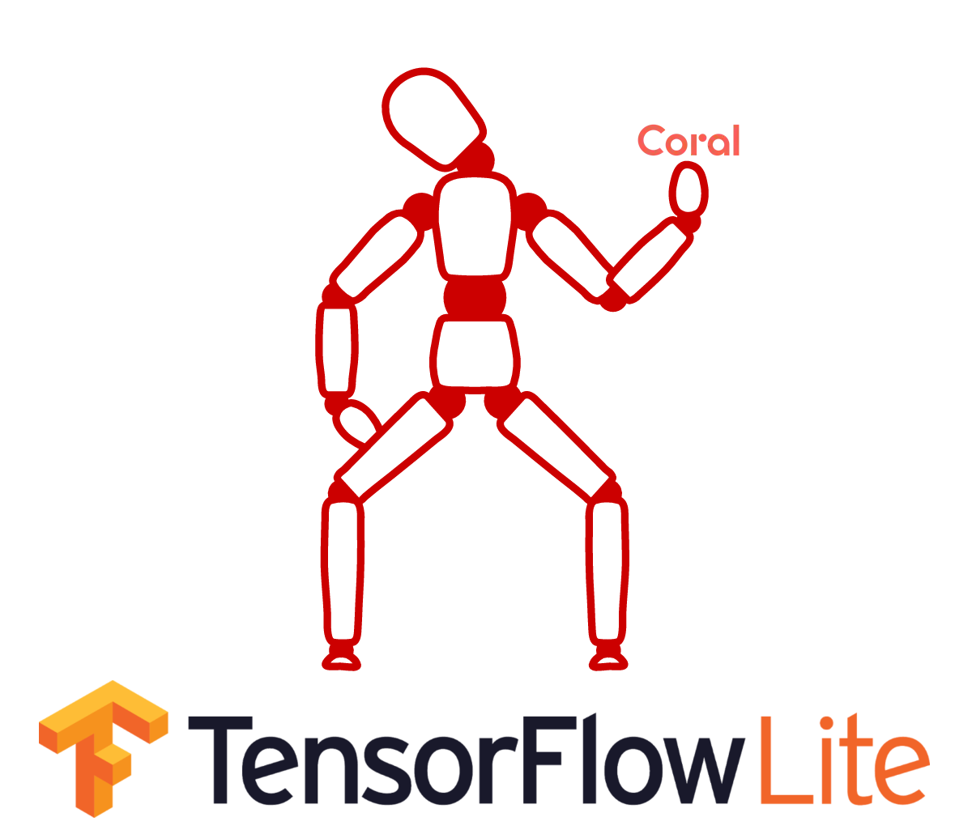
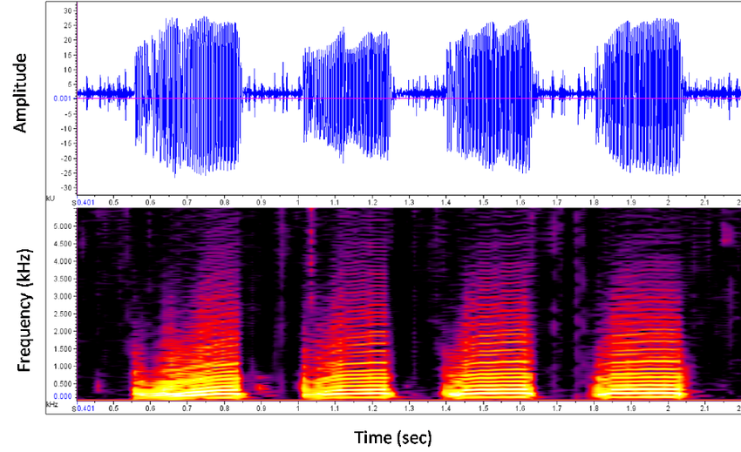
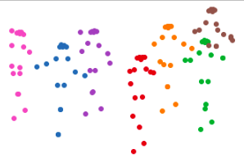
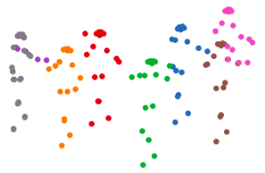
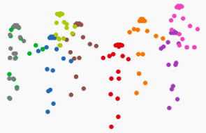
Refresher
Fake Dance Data
Time-series GANs with RNNs are expensive
No RNN
Custom dataset
?
?
Audio Slice
Discriminator
Real? fAkE?
PoseNet
START
Real Dance Data
Collin

Slide 4
Dataset
Made custom dataset!
Data
Solution
Find/create dataset with human poses as coordinates and songs converted to frequency-domain
Data has to come from somewhere
Collin

Slide 5
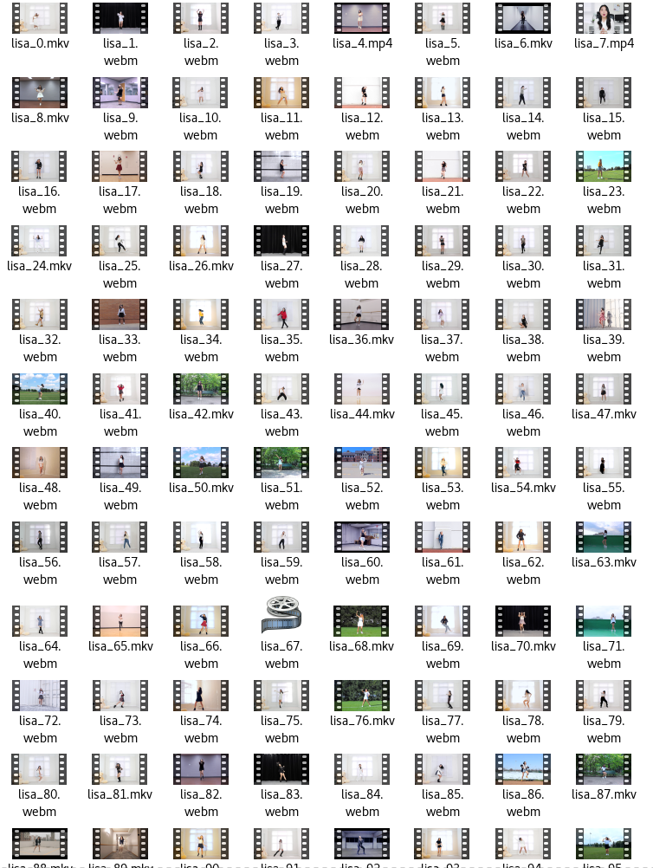
Dataset
(Video)
Data
Solution
Find/create dataset with human poses as coordinates and songs converted to frequency-domain
Data has to come from somewhere
This took forever to get working
Download speeds were ok
Sending all of data through OpenPose on my laptop was not fun. Took about 6 hours for 1:30 of footage @ 24-60 FPS
Let’s Dance and YouTube 8M did not have audio
Manually downloaded KPop Solo Dance Cover videos from YouTube (pytube)
Ran each .mp4 file through OpenPose
Exhausting, took several days to just install OpenPose correctly, several more to process data on GPU
Collin

Slide 6
Dataset
(Video)
Data
Solution
Find/create dataset with human poses as coordinates and songs converted to frequency-domain
Data has to come from somewhere
This took forever to get working
Download speeds were ok
Sending all of data through OpenPose on my laptop was not fun. Took about 6 hours for 1:30 of footage @ 24-60 FPS
This 24-60 FPS number varied. It was the worst because the audio sampling rate was the same for all audio files, so I had to do a lot of work to sample properly.
Collin

Slide 7
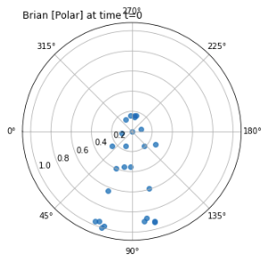
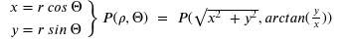
Dataset
(Video)
Data
Solution
Find/create dataset with human poses as coordinates and songs converted to frequency-domain
Data has to come from somewhere
Audio frames sampled @ 48 KHz or 44.1 KHz (fun!)
Because of varying sampling rates and frame rates, I had to choose a smaller window for each sampling rate
Each “chunk” of pose data turned out to be 16 pose vectors (Polar coordinates) with 25 channels (one for each keypoint) centered around the neck
PoseNet
Collin

Slide 8
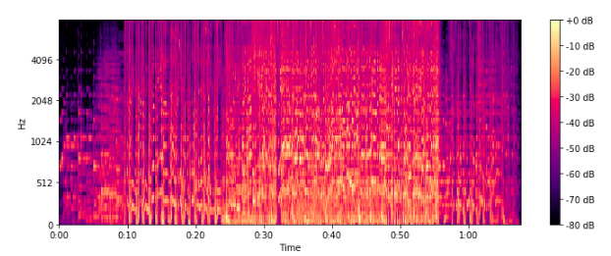
Dataset
(Audio)
Each pose frame has a corresponding audio slice
Data
Solution
Find/create dataset with human poses as coordinates and songs converted to frequency-domain
Data has to come from somewhere
Audio frames sampled @ 48 KHz or 44.1 KHz (fun!)
Because of varying sampling rates and frame rates, I had to choose smaller window for each sampling rate
Each “chunk” of pose data turned out to be 16 pose vectors (Polar coordinates) with 25 channels (one for each keypoint) centered around the neck
Stereo Audio (2-channel) in .wav got FFT’d to Mel Spectrogram (once for each channel)
PoseNet
Collin

Slide 9
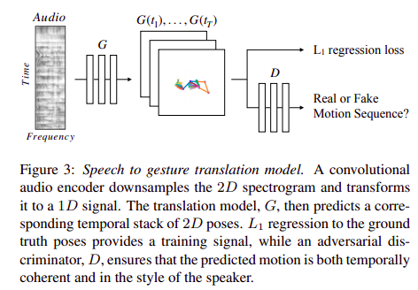
GAN Architecture
Generation
Solution
Solution
Solution
Time-Series Prediction
Time-Series Prediction
Actually creating new sequences
Find/create dataset with human poses as coordinates and songs converted to frequency-domain
Use a GAN
Use LSTM/RNN to deal with time-series data
Data has to come from somewhere
Training on data with time as a variable
Inspiration from Speech2Gesture architecture
Difficulty in getting a good PyTorch equivalent of Speech2Gesture model due to only Tensorflow being available and not-great documentation
Convolution along input data is fine! It acts just like an image
Collin

Slide 10
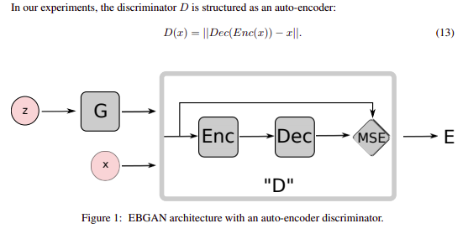
GAN Architecture
Generation
Solution
Solution
Solution
Time-Series Prediction
Time-Series Prediction
Actually creating new sequences
Find/create dataset with human poses as coordinates and songs converted to frequency-domain
Use a GAN
Use LSTM/RNN to deal with time-series data
Data has to come from somewhere
Training on data with time as a variable
Modified EBGAN instead (based on pytorch-generative-models on GitHub)
Collin

Slide 11
GAN Architecture
Batch_size x 2 channels x 32 slices x 64 filters
Batch_size x 25 keypoints x 16 poses x 2 (phi, rho)
Generation
Solution
Solution
Solution
Time-Series Prediction
Time-Series Prediction
Actually creating new sequences
Find/create dataset with human poses as coordinates and songs converted to frequency-domain
Use EBGAN
Use LSTM/RNN to deal with time-series data
Data has to come from somewhere
Training on data with time as a variable
Modified EBGAN instead (based on pytorch-generative-models on GitHub)
Surrounding audio acts as input
32 audio-slices for 16 pose vectors to capture past, present, and future information
Collin

Slide 12
GAN Architecture
Batch_size x 2 channels x 32 slices x 64 filters
Batch_size x 25 keypoints x 16 poses x 2 (phi, rho)
Generation
Solution
Solution
Solution
Time-Series Prediction
Time-Series Prediction
Actually creating new sequences
Find/create dataset with human poses as coordinates and songs converted to frequency-domain
Use EBGAN
Use LSTM/RNN to deal with time-series data
Data has to come from somewhere
Training on data with time as a variable
Modified EBGAN instead (based on pytorch-generative-models on GitHub)
Surrounding audio acts as input
32 audio-slices for 16 pose vectors to capture past, present, and future information
Collin

Slide 13
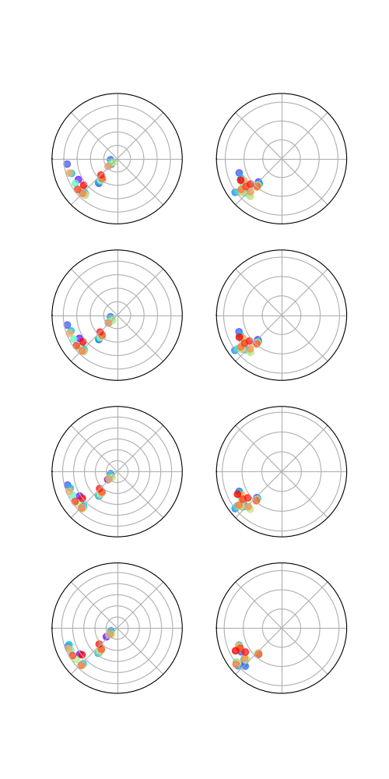
Results
Frame
1 2
Sequence 1
Sequence 2
Sequence 3
Sequence 4
GIF of four generated 2-pose sequences
Generation
Solution
Solution
Solution
Time-Series Prediction
Time-Series Prediction
Actually creating new sequences
Find/create dataset with human poses as coordinates and songs converted to frequency-domain
Use EBGAN
Use LSTM/RNN to deal with time-series data
Data has to come from somewhere
Training on data with time as a variable
L1 Loss Function
Pullaway loss is built into EBGAN
GIF demonstrates generated output after each epoch (50 epochs in total)
You can see in the first frame that it has spread-out poses but almost immediately collapses
Generator loss consistently high, discriminator loss consistently low
Currently working on modifying architecture to include UNet, different loss function
Collin

Slide 14
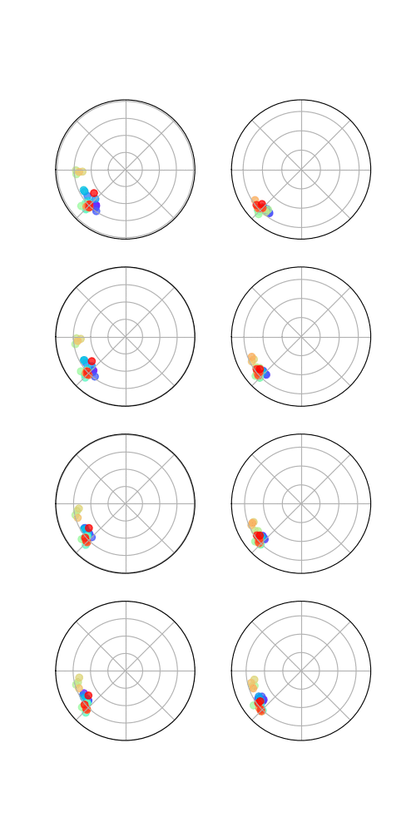
Results 2
Frame
1 2
Sequence 1
Sequence 2
Sequence 3
Sequence 4
GIF of four generated 2-pose sequences
Generation
Solution
Solution
Solution
Time-Series Prediction
Time-Series Prediction
Actually creating new sequences
Find/create dataset with human poses as coordinates and songs converted to frequency-domain
Use EBGAN
Use LSTM/RNN to deal with time-series data
Data has to come from somewhere
Training on data with time as a variable
Modified architecture to use UNet as Discriminator instead of builtin conv-linear-deconv structure
Better results!
But the points do squash to phi = 1
Collin

Slide 15
Limitations
Problem A: Not enough data
The model finished 100 epochs in under 15 minutes. Clearly more data is required
I will collect data for the next few days and provide an update by the last day of the semester
Problem B: Data sampling difficulty
When dealing with the downloaded data, there were a wide array of video frame rates (60, 30, 25, 24 FPS) coupled with differing audio sample rates (48 KHz, 44.1 KHz)
This leads to inconsistency between collected samples, which might make it difficult for the model to learn properly
Had to define “good” vs “bad” frames in term of motion/presence of keypoints
Cut down dataset size by about half
Collin

Slide 16
Conclusions
Can we generate poses from audio samples?
Yes
Are the generated poses good?
No
Is this solvable?
Yes
How is this solvable?
More data, better loss function
Collin

Slide 17
Future Work
Over the next week, I will:
Create a much larger dataset and test it on different architectures
Find a better loss function
Collin

Slide 18
References
[1]https://www.isca-speech.org/archive/archive_papers/interspeech_2012/i12_0194.pdf
[2]https://www.isca-speech.org/archive/archive_papers/interspeech_2010/i10_1045.pdf
[3]http://people.eecs.berkeley.edu/~shiry/projects/speech2gesture/
[4] https://arxiv.org/pdf/1609.03126.pdf
[5]https://github.com/znxlwm/pytorch-generative-model-collections
[6]https://www.cv-foundation.org/openaccess/content_iccv_2015/papers/Kendall_PoseNet_A_Convolutional_ICCV_2015_paper.pdf
[7]https://www.semanticscholar.org/paper/A-parallel-fusion-RNN-LSTM-architecture-for-image-Wang-Song/617d46d0172cc61a0470fc4b5d1f3723baf1458e

